Slide 1
What are your top 3 favorite movies?
The Fellowship of the Ring
Titanic
The Power of One (with Daniel Craig)
Notes:
https://www.ncsc.gov.uk/static-assets/documents/PwnedPasswordsTop100k.txt

Slide 2
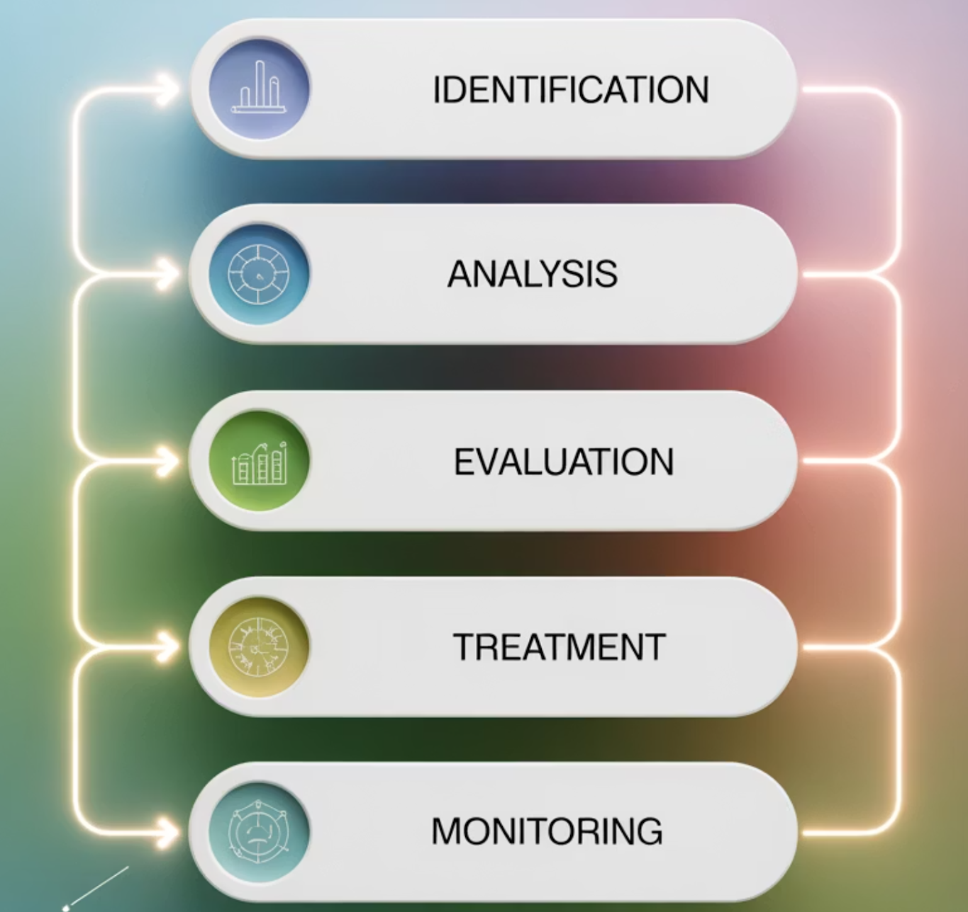
Risk Assessment for Resilience
Risk assessment identifies and evaluates potential threats to an organization's resources, processes, and reputation. It's a critical step in building resilient strategies and making informed decisions.
Key Learnings
Role of risk assessment in resilience planning
Methods for threat and vulnerability identification
Risk prioritization and scoring
Integrating risk with business continuity strategies
1
Notes:
Risk: the chance a threat exploits a weakness and causes damage
Outcome of threat + vulnerability
Always tied to impact level
Gives direction for decision-making
Helps prioritize what to fix first
Changes over time as environment shifts
Example Driving a car in heavy rain increases the chance of skidding — the rain is the threat, worn tires are the vulnerability, and a crash is the impact.

Slide 3
CLASS AGENDA
CLASS OBJECTIVES
Intro to risk & resilience
Risk assessment overview
Tools & frameworks
Risk prioritization & scoring
Applying results to planning
Define risk assessment & its role
Identify threats, vulnerabilities & assets
Explain qualitative vs. quantitative analysis
Connect results to continuity & recovery

Slide 4
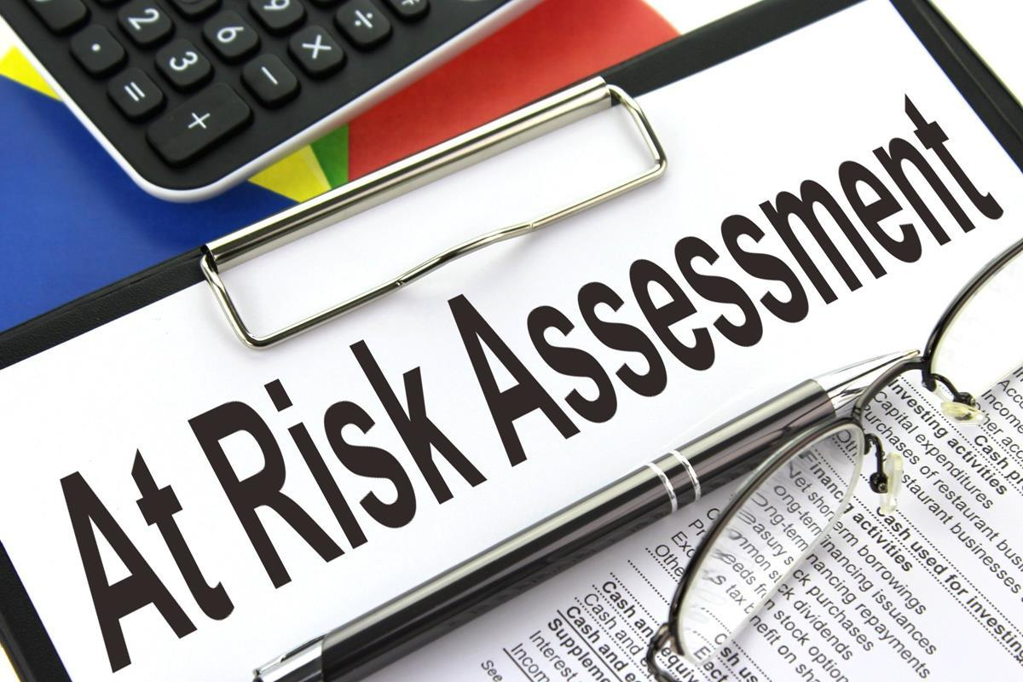
Risk Assessment: The Foundation
Risk assessment is a structured process to identify, analyze, and evaluate potential threats and vulnerabilities. It forms the analytical foundation for effective resilience investments and continuity planning.
Systematic identification of threats and vulnerabilities
Analysis of likelihood and impact scenarios
Guides resilience investments and protection strategies
Continuously updated for evolving risks
Notes:
Definition: Risk assessment = structured review of threats, weaknesses, and potential impacts
Identifies what could disrupt operations
Shows which risks matter most
Supports planning and investment decisions
Helps anticipate issues before incidents
Continuous updates keep plans relevant
Example Like checking your car’s brakes, lights, and tires before a long drive.

Slide 5
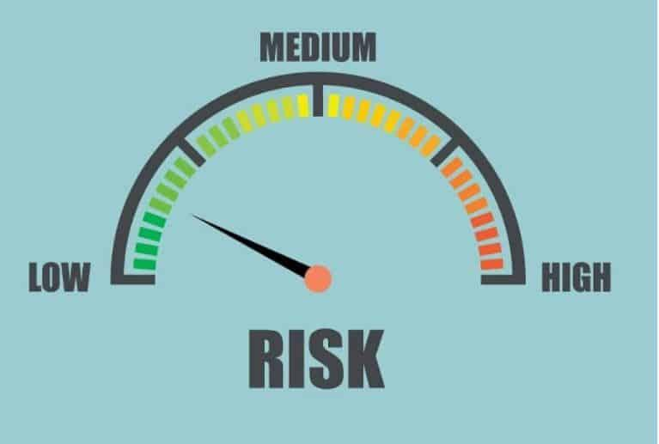
Risk Assessment: Powering Resilience
Risk assessment identifies vulnerabilities *before* they become disruptions. It enables proactive resource allocation to build defenses and prevent incidents, shifting focus from reactive response to strategic prevention.
Moves from reactive incident response to proactive threat mitigation.
Guides strategic resource allocation to critical vulnerabilities.
Ensures regulatory compliance and strong governance.
Aligns operational risks with business continuity priorities.
Fosters a shared understanding of organizational risk exposure.
Notes:
Definition: Resilience = ability to anticipate, absorb, and adapt to disruption
Moves focus from reacting to preventing
Directs resources to major vulnerabilities
Supports compliance and regulations
Aligns risks with continuity priorities
Helps everyone understand risk exposure
Example Installing smoke detectors reduces the chance a fire spreads before you notice.

Slide 6
Key Concepts: Threats, Vulnerabilities, Impacts
Understanding these fundamental risk components enables precise analysis and targeted mitigation strategies.
Threats
Vulnerabilities
Impacts
External events or actors capable of harming organizational assets, processes, or reputation.
Internal weaknesses that threats can exploit, leading to disruption or damage.
Consequences when threats successfully exploit vulnerabilities.
Financial losses & revenue disruption
Cyberattacks & malware
Outdated security controls
Natural disasters
Single points of failure
Reputational damage
Supply chain disruptions
Inadequate staff training
Regulatory penalties
Regulatory changes
Insufficient backup capabilities
Operational downtime
Notes:
Definitions: Threat = something that can cause harm Vulnerability = weakness a threat can exploit Impact = consequence of a disruption
Threats are external drivers
Vulnerabilities come from internal weakness
Impacts are the result of both
Understanding this trio improves risk clarity
Helps target mitigation actions
Example Rain (threat) hitting a cracked roof (vulnerability) causes water damage (impact).

Slide 7
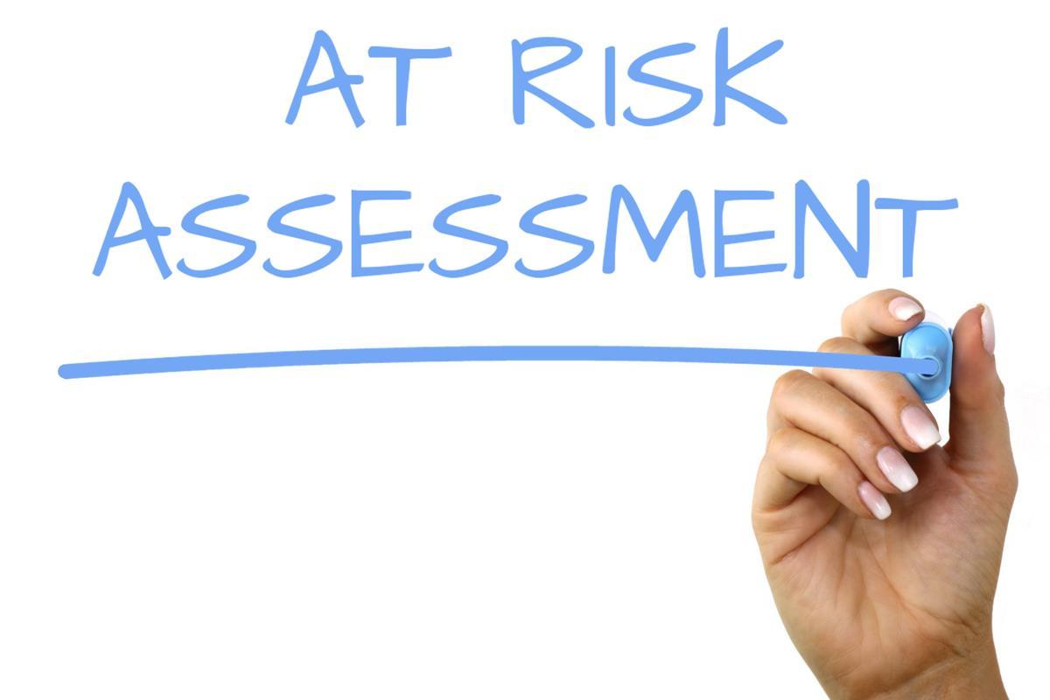
The Risk Assessment Process
A systematic approach to identifying, assessing, and treating risks ensures comprehensive coverage and consistent results.
Identify: Catalog threats, vulnerabilities, and critical assets.
Analyze: Evaluate likelihood and potential impact.
Evaluate: Prioritize risks by severity.
Treat: Implement mitigation strategies.
Monitor: Track changes and validate controls.
Notes:
Key definitions from slide: Identify, Analyze, Evaluate, Treat, Monitor = core steps of risk handling
Identify what could go wrong
Analyze likelihood and impact
Evaluate which risks matter most
Treat high-priority risks with controls
Monitor changes to keep assessment current
Example Like diagnosing a health issue: check symptoms, assess severity, choose treatment, follow up.

Slide 8
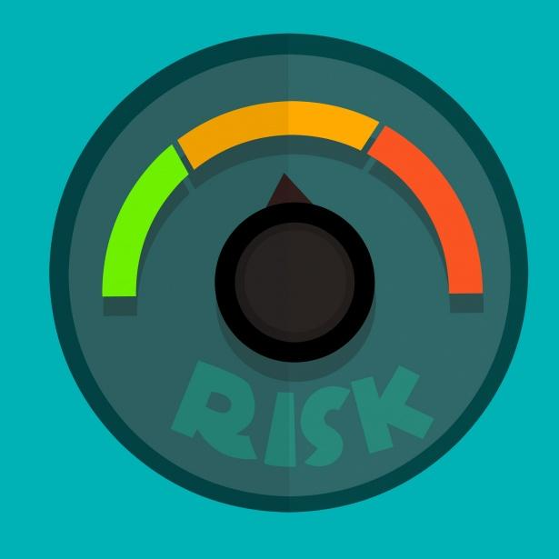
Risk Analysis: Qual vs. Quant
Selecting the right risk analysis method depends on data, resources, and decision-making needs.
Qualitative: Rapid assessment using descriptive scales (e.g., High/Medium/Low).
Quantitative: Precise, data-driven with numerical probability and financial impact.
Key Elements: Both assess probability (likelihood) and impact (consequences).
Hybrid Approach: Combine qualitative screening with quantitative deep dives for critical risks.
Notes:
Definitions: Qualitative = descriptive scoring Quantitative = numeric scoring
Qualitative gives quick high/medium/low view
Quantitative gives numeric cost/likelihood
Hybrid combines both for depth
Both aim to measure probability + impact
Choice depends on available data
Example Judging weather: “looks cloudy” (qualitative) vs “90 percent chance of rain” (quantitative).

Slide 9
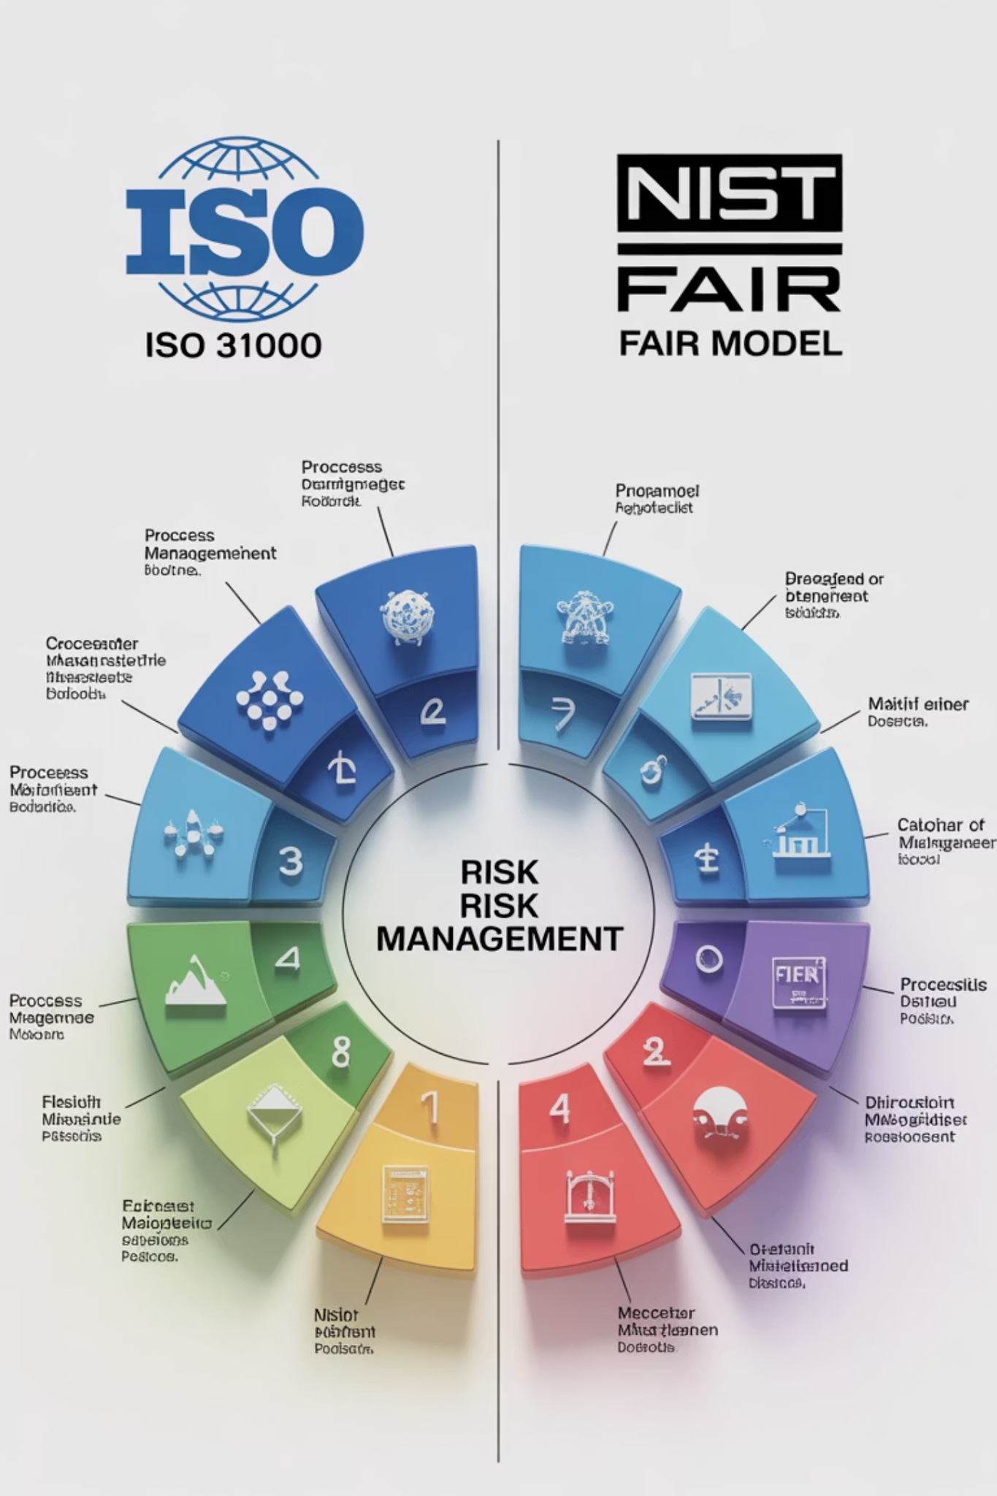
Risk Management Frameworks
Standardized frameworks offer structured, comprehensive approaches to managing risk across various domains.
ISO 31000: Global standard for risk principles and processes, adaptable to any context.
NIST SP 800-30: Detailed guidance for cybersecurity risk assessment.
FAIR Model: Quantitative approach using frequency and magnitude for financial risk.
COSO ERM: Enterprise-wide framework linking risk to strategy and governance.
OCTAVE: Organizational self-assessment for critical IT assets and threats.
Notes:
Definition: Framework = standardized method for managing risk
Provides structure for consistent assessment
Guides documentation and decisions
Aligns risk with governance practices
Supports regulatory requirements
Helps teams use common language
Example Like following a fitness program template rather than making workouts up randomly.

Slide 10
Identifying Critical Business Assets
Effective risk assessment starts with identifying and prioritizing critical assets that require protection, including functions and third-party providers.
Technology Assets
Information Assets
Critical applications and databases
Customer data and financial records
Network infrastructure and connectivity
Intellectual property and trade secrets
Cloud services and third-party platforms
Operational procedures and documentation
Backup systems and recovery environments
Strategic plans and competitive intelligence
Physical Assets
Human Assets
Primary and alternate facilities
Key personnel and specialized expertise
Manufacturing equipment and machinery
Customer relationships and reputation
Transportation and logistics capabilities
Vendor partnerships and supply chains
Utilities and environmental controls
Regulatory approvals and licenses
Notes:
Definition: Critical asset = anything essential for operations (systems, data, people, facilities)
Focus on what the organization cannot lose
Includes tech, data, physical sites, and key staff
Prioritize assets that support revenue and customers
Helps define what needs strongest protection
Drives smarter recovery planning
Example A café’s espresso machine is more critical than posters on the wall because it directly affects sales.

Slide 11

Threat & Vulnerability Mapping
Visual risk mapping clarifies priorities and identifies critical vulnerabilities, concentrating on high-impact areas and interdependencies.
Risk Heatmaps: Visualizes critical risks by probability and impact.
Dependency Analysis: Identifies cascading failures and single points of failure.
Threat Actor Profiling: Understands adversary capabilities and motivations.
Vulnerability Scanning: Assesses system weaknesses and configuration gaps.
Notes:
Definitions: Heatmap = visual risk chart Dependency analysis = mapping connections
Heatmaps show risk severity
Mapping reveals cascading failures
Profiles identify threat behavior
Scanning finds weaknesses
Clarifies top priorities
Example Like checking the weakest links in a chain so you know where it will snap first.

Slide 12
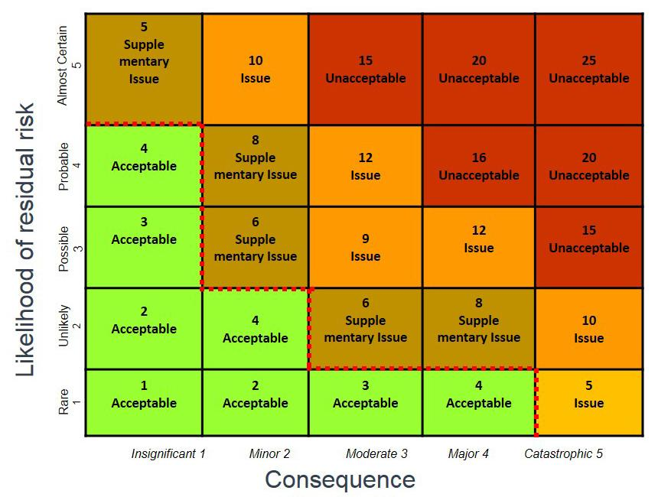
Risk Scoring & Prioritization
Objective risk scoring enables clear comparison and resource allocation. A consistent approach ensures transparent and reproducible prioritization.
Likelihood Assessment: Evaluate probability based on data and intelligence.
Impact Analysis: Quantify financial, operational, and reputational consequences.
Risk Rating: Combine likelihood and impact for comparable scores.
Priority Ranking: Systematically prioritize risks for resource allocation.
Notes:
Likelihood = chance event happens Impact = damage caused
Score risks by combining probability + impact
Higher score = higher priority
Ranking helps allocate resources
Standard scoring improves consistency
Simplifies decision-making
Example Choosing which chores to do first: you handle the most urgent or risky ones first.

Slide 13
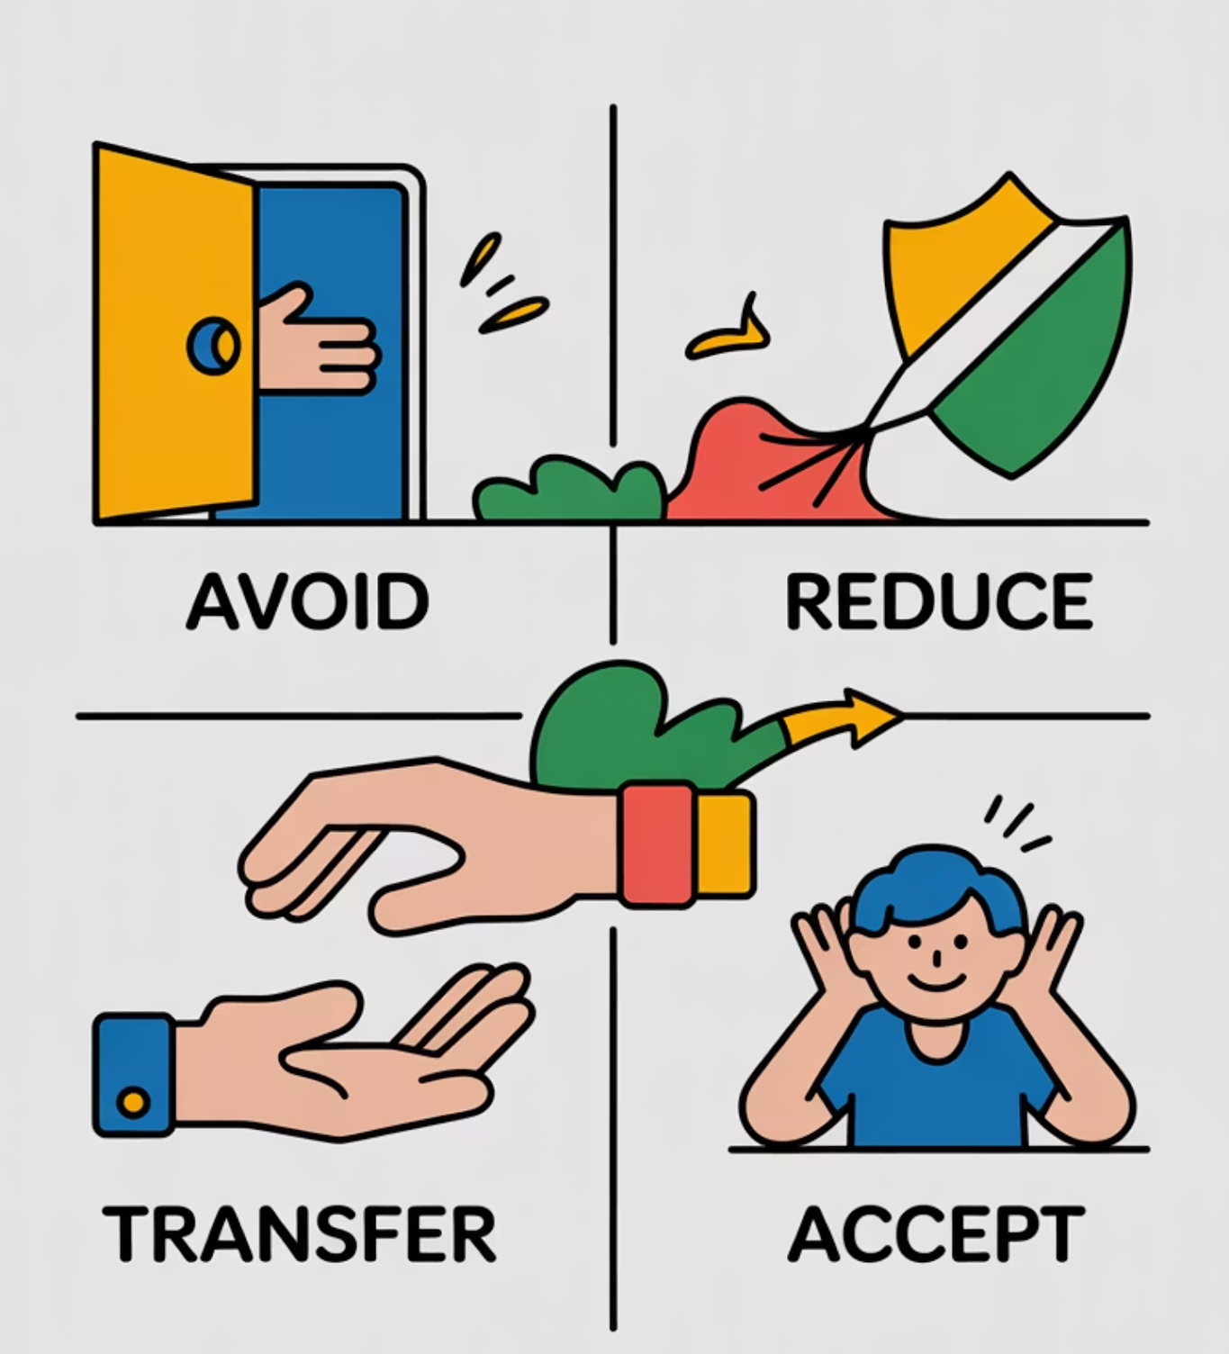
Risk Treatment Strategies
Strategies must align with risk tolerance and available resources. Each option involves different investments and results in distinct levels of remaining risk.
Avoidance: Eliminate risk by discontinuing activities or changing operations.
Reduction: Implement controls to decrease likelihood or limit potential impact.
Transfer: Shift risk to third parties (e.g., insurance, contracts).
Acceptance: Acknowledge risk when mitigation costs outweigh benefits.
Notes:
Avoidance = eliminate risk Reduction = lower risk Transfer = shift risk Acceptance = tolerate risk
Choose approach based on severity
Avoid if too dangerous
Reduce using controls
Transfer through insurance or contracts
Accept when impact is low
Example You avoid a dangerous road, reduce risk by driving slowly, transfer risk with insurance, accept a small scratch risk.

Slide 14




Risk & Resilience: An Integrated Approach
Aligning risk assessment with resilience planning ensures targeted investments and robust preparedness.
Risk Assessment
Resilience Strategy
Identify threats, vulnerabilities, & impacts.
Design controls to minimize disruptions.
Continuity Planning
Recovery Preparation
Develop procedures to maintain operations.
Build capabilities for systematic restoration.
Notes:
Definition: Integration = connecting risk assessment with continuity strategy
Assessment identifies problems
Strategy designs protections
Continuity maintains operations
Recovery restores functions
All four work together
Example Like planning for a storm: inspect roof (risk), reinforce it (strategy), prepare supplies (continuity), clean up after (recovery).

Slide 15

Cyber Risk Assessment: Financial Firm Case Study
A regional bank performed a cyber risk assessment to guide resilience planning, revealing vulnerabilities and informing strategic security investments.
1
2
3
1. Identify Critical Assets
2. Analyze Threats
3. Assess Vulnerabilities
Cataloged customer data, trading systems, & payment platforms.
Identified ransomware, insider threats, & regulatory risks.
Discovered outdated patches, inadequate backup testing, & limited incident response.
4
5
4. Evaluate Impact
5. Implement Resilience
Quantified potential losses: fines, customer attrition, & operational downtime.
Invested in network segmentation, enhanced monitoring, & BCP.
Result: $2.3M investment reduced cyber risk by 75% and achieved regulatory compliance.
Notes:
Definition: Case study = real example showing risk process in action
Identifies key systems and data
Finds top threats
Exposes major weaknesses
Quantifies damage
Invests in controls
Example A bank updating outdated security software to avoid ransomware after seeing gaps in assessment.

Slide 16








Continuous Monitoring & Review
Continuous monitoring ensures risk assessments remain current and actionable. This ongoing process is vital for maintaining readiness and adapting to new threats.
Event-Driven Updates
Scheduled Reviews
Immediate reassessments after incidents, new threats, or operational changes.
Quarterly risk register updates and annual comprehensive assessments.
Stakeholder Input
Trend Analysis
Regular consultation with business units and external threat intelligence.
Identify patterns and emerging threats through continuous monitoring.
This iterative process ensures risk assessment aligns with organizational priorities and supports resilience planning in dynamic environments.
Notes:
Definition: Monitoring = ongoing tracking of risks and changes
Update risk register
Reassess after incidents
Watch for emerging threats
Engage stakeholders
Keep risk picture accurate
Example Like checking your phone’s battery level throughout the day to avoid shutdown.

Slide 17

Key Principles for Resilience
Building organizational resilience requires a strategic approach to risk.
Foundation for Resilience: Proactively mitigate threats through comprehensive risk assessment.
Targeted Investment: Prioritize defenses based on identified threats and vulnerabilities.
Resource Efficiency: Optimize security resource allocation with systematic scoring and prioritization.
Strategic Planning: Directly inform Business Continuity and Recovery strategies.
Dynamic Relevance: Ensure ongoing accuracy and timeliness through continuous monitoring.
Resilience begins with understanding your risks and acting before disruption. Proactive investment in risk assessment is crucial for effective resilience planning and demonstrating clear value to stakeholders.
Notes:
Definition: Principle = guiding idea for strong resilience
Reduce risk early
Invest based on priority
Optimize resource use
Align with continuity goals
Keep info updated
Example Strength training improves balance, stability, and injury prevention — same principle for resilience.

Slide 18

Purpose of BIA: Identifying Essential Functions
A Business Impact Analysis (BIA) identifies and prioritizes critical business functions for continuity planning, ensuring organizational resilience during disruptions.
Learning Outcomes
Define BIA's role in resilience & continuity
Distinguish essential from supporting functions
Understand prioritization & impact assessment
Link BIA to recovery planning & resource allocation
1
Notes:
Definition: BIA = analysis that shows which functions are essential and time-critical
Identifies which processes must stay running
Links disruptions to financial and operational impact
Shows which functions need priority recovery
Guides resource allocation during planning
Connects resilience actions to business value
Example A grocery store prioritizes keeping refrigerators powered before anything else because food spoils quickly.

Slide 19
CLASS AGENDA
CLASS OBJECTIVES
Introduction to Business Impact Analysis (BIA)
BIA purpose & strategic outcomes
Identifying essential & time-critical functions
Evaluating impacts & organizational dependencies
Applying BIA results to recovery planning
Define BIA's role in enterprise resilience
Identify essential & time-critical functions
Explain financial, operational, & reputational impacts
Relate BIA to DRI Professional Practices 3 & 4

Slide 20
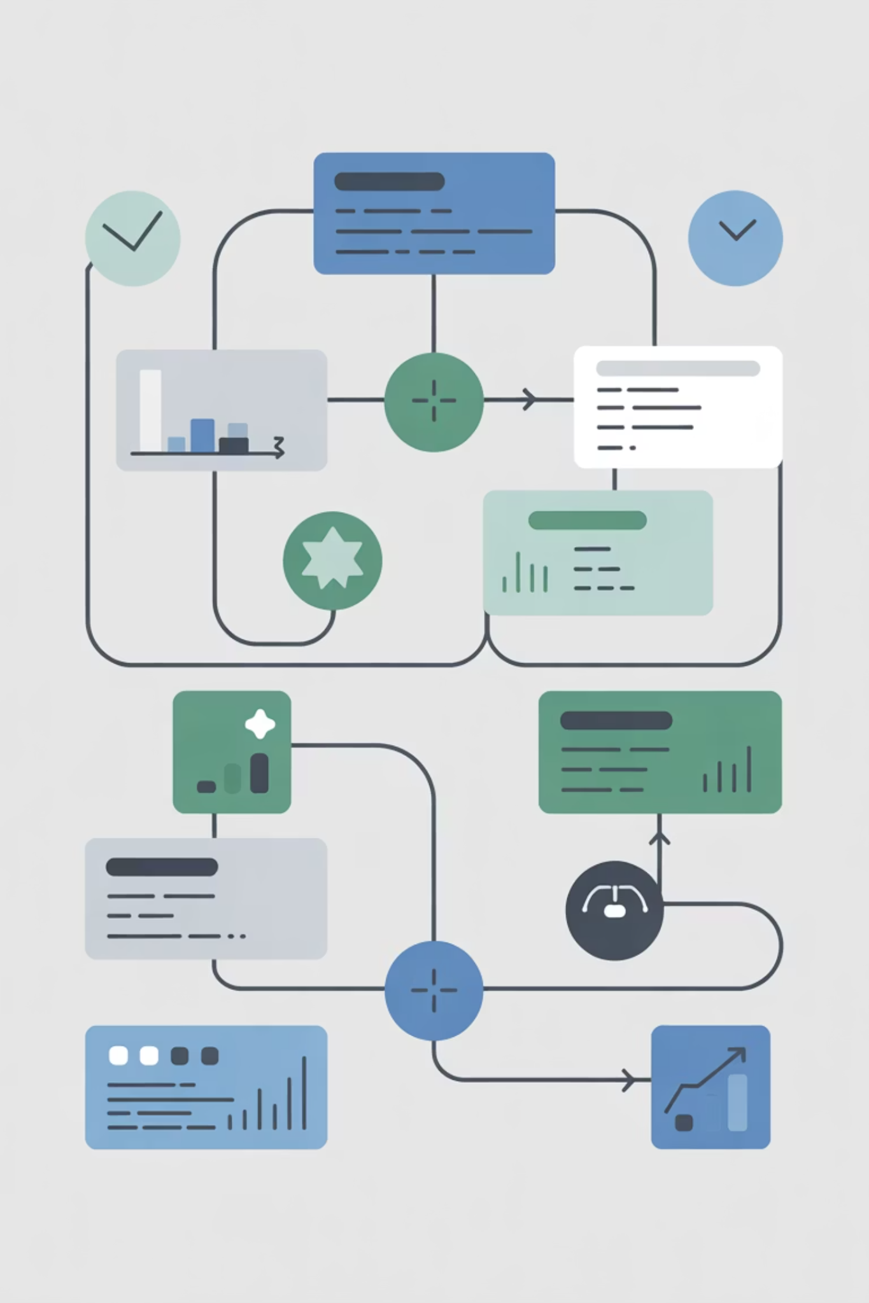
What Is a Business Impact Analysis (BIA)?
A BIA systematically identifies and evaluates the potential effects of critical business operation interruptions due to disasters or emergencies. It forms the core analytical foundation for all business continuity and disaster recovery planning.
Identifies impacts of disruptions and critical functions for recovery.
Key component of DRI Professional Practice 3.
Pinpoints essential business functions, systems, staff, and technology.
Provides data for resource allocation and recovery strategies.
Links risk assessment to practical continuity planning.
Notes:
Definition: BIA = method to measure consequences of disruption
Identifies key functions
Shows how disruption affects customers
Calculates business consequences
Provides recovery requirements
Sets factual data for decision-making
Example When your fridge breaks at home, you quickly learn which foods spoil first — that’s BIA logic.

Slide 21

The Purpose of a BIA
A BIA predicts disruption consequences, providing data to create recovery strategies. It transforms abstract risks into concrete operational priorities.
Prioritizes recovery based on business impact.
Justifies budget and pitches continuity plans.
Establishes time-sensitive recovery objectives.
Identifies critical functions with greatest impact.
Creates measurable criteria for resilience investments.
Provides strategies to minimize unplanned event impact.
Notes:
Definition: Essential function = process needed for the organization’s mission
Revenue activities
Compliance-driven procedures
Critical service delivery
IT and security support
Customer-facing operations
Example A hospital’s emergency room is more critical than its gift shop.

Slide 22

Identifying Essential Functions
Identifying essential functions is key to a BIA. These are mission-critical processes and their supporting systems, vital for an organization's core mission, requiring full awareness across the business.
Revenue Generation: Sales, Customer Service, Billing
Regulatory Compliance: Financials, Audits, Legal
Critical Operations: Manufacturing, Service Delivery
Foundational Support: IT, Payroll, Security
Resource Dependence: People, Tech, Facilities
Customer-Facing: Impacts Reputation & Market

Slide 23

Criteria for Determining Criticality
Define and approve criticality criteria to ensure consistent, objective assessment and prioritization of essential functions.
Time sensitivity: Max tolerable downtime (hours/days/weeks)
Financial impact: Revenue loss, additional costs, penalties
Legal & Regulatory: Compliance violations, fines, legal liability
Operational dependencies: Impact on other processes & partnerships
Reputational risk: Customer confidence, brand, stakeholder trust
Strategic importance: Competitive advantage, long-term viability
Notes:
Definition: Criticality criteria = rules for grading process importance
Time sensitivity
Financial impact
Legal/regulatory consequences
Dependencies on other processes
Customer/reputation impact
Example Paying employees on time is critical — delays affect morale and can violate laws.

Slide 24

Understanding Dependencies
Essential functions rely on complex internal and external interdependencies. Mapping these dependencies helps identify how disruptions cascade and reveals single points of failure.
People: Key personnel, specialized skills, succession planning
Technology: Critical applications, data, network, cloud services
Facilities: Physical locations, utilities, security systems
Vendors & Suppliers: Third-party services, supply chains, contracts
Processes: Workflows, data flows, approval chains, communication
Regulatory: Compliance, reporting, legal frameworks
Notes:
Definition: Dependency = something a process relies on to function
People with specific skills
Technology systems
Facilities and utilities
Vendors and partners
Regulatory requirements
Example A restaurant depends on power for refrigerators, ovens, and payment systems.

Slide 25
Impact Categories and Tiers
Impact categorization creates a framework for prioritizing recovery efforts and resource allocation, guided by Recovery Time Objectives (RTOs) and Recovery Point Objectives (RPOs).
High Impact (Tier 1)
Medium Impact (Tier 2)
Low Impact (Tier 3)
RTO: 0-4 hrs
RTO: 4-24 hrs
RTO: 1-7 days
Characteristics: Mission-critical, immediate revenue/regulatory impact
Characteristics: Important ops, indirect revenue/efficiency impact
Characteristics: Non-essential, minimal immediate impact
Internal business systems
Training systems
Customer transaction systems
Administrative functions
Archive functions
Safety & security ops
Support operations
Dev environments
Real-time manufacturing
Notes:
Definition: Impact tier = ranking based on severity of disruption
Tier 1 = highest impact
Tier 2 = moderate impact
Tier 3 = low impact
Defines RTO urgency
Helps prioritize restoration sequence
Example Losing electricity (tier 1) is worse than losing your TV remote (tier 3).

Slide 26

Gathering and Validating Data
Accurate BIA outcomes depend on comprehensive data collected from knowledgeable representatives, with methodology directly impacting completeness.
Stakeholder interviews: Process owners, subject matter experts, end users.
Structured questionnaires: Impact scenarios, resource requirements.
Documentation review: Process flows, system architecture, compliance needs.
Validation workshops: Cross-functional review, assumption testing, executive sign-off.
Data triangulation: Multiple source verification, gap identification.
Notes:
Definition: Validation = confirming accuracy of collected information
Interviews capture actual workflows
Questionnaires document impacts
Reviews verify assumptions
Workshops bring groups together
Triangulation fills gaps
Example Like asking multiple family members what happened to confirm the true story.

Slide 27

Using BIA Results in Planning
BIA reports, combined with risk assessments, define recovery strategies for critical processes. This analysis translates into actionable plans that guide resilience investments and operational decisions.
BIA informs cost-effective deficiency reduction and recovery strategies.
Defines critical functions for immediate recovery, foundational for disaster recovery.
Guides resource allocation based on impact tiers and recovery time objectives.
Prioritizes technology investments aligned with business criticality.
Enables business continuity planning for disruption resilience.
Focuses testing and exercise programs on high-impact scenarios.
Notes:
Definition: Physical assets = locations, equipment, and infrastructure supporting operations
Buildings house operations
Utilities keep systems running
Machinery enables production
Storage supports inventory
Alternate sites act as backup
Example A grocery store can’t operate if its main building floods — physical space is essential.

Slide 28
BIA Pitfalls & Best Practices
Effective BIA requires proper application and methodology. Avoiding common errors and following proven practices enhances BIA effectiveness and organizational outcomes.
Common Pitfalls
Best Practices
Insufficient stakeholder engagement: Limited input
Cross-functional collaboration: Include all critical areas
Unclear criteria: Subjective assessments
Outdated data: Analysis not updated
Management-approved criteria: Objective standards
Technology-centric: Ignores process/human factors
Regular updates: Annually or with significant changes
Lack of executive validation: No senior approval
Integration with testing: Validate assumptions
Executive presentation: Senior review and governance
Notes:
Definition: Dependency mapping = visualizing relationships between processes and resources
Shows process connections
Reveals hidden reliance points
Identifies cascade effects
Highlights single points of failure
Supports planning and prioritization
Example Like seeing how one shared power strip connects multiple devices — if strip fails, all fail.

Slide 29
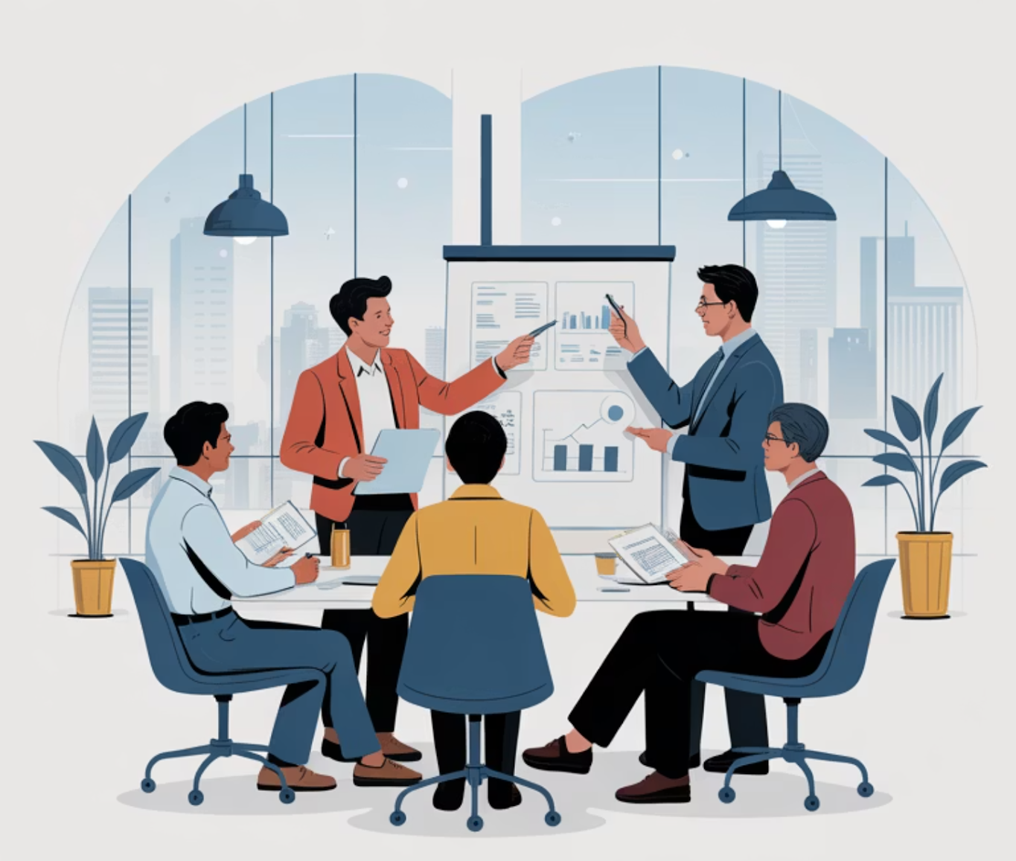
Key Takeaways
Identifies critical functions, recovery priorities, and interdependencies.
Quantifies financial & non-financial impacts for targeted recovery.
Maps interdependencies, revealing hidden weaknesses.
Guides strategy, testing, and resource allocation.
A strong BIA ensures organizational resilience starts with what matters most.
The BIA is the critical link between risk assessment and business continuity planning. It defines the "what" and "why" for resilience, turning abstract concepts into concrete priorities to protect enterprise value during disruptions.

Slide 30
BREAK TIME
Be back in 15 mins.
Notes:
https://www.ncsc.gov.uk/static-assets/documents/PwnedPasswordsTop100k.txt

Slide 31

Identifying Key Business Processes and Resources (Systems, Data, People, Facilities)
Recognizing core processes and supporting resources is the foundation for organizational resilience, recovery planning, and effective continuity management. Understanding what drives your business enables you to protect what matters most when disruptions occur.
Define key business processes and their criticality criteria
Identify supporting resources and map critical dependencies
Understand their essential role in business impact analysis
Connect process identification to resilience and recovery strategies
1
Notes:
Definition: Process identification = method to discover how work actually happens
Interviews collect expert input
Walkthroughs reveal real operations
Documents show formal structure
RACI shows responsibilities
Value stream shows customer flow
Example Walking behind a pizza chef to see how each step leads to a finished pizza.

Slide 32
CLASS AGENDA
CLASS OBJECTIVES
Introduction to business process identification
Linking processes to resilience goals
Categorizing resources (systems, data, people, facilities)
Mapping dependencies and interconnections
Documenting findings for continuity planning
Define key business processes and supporting resources
Recognize dependencies between functions and systems
Explain why accurate documentation is essential for resilience
Relate this activity to DRI Professional Practices 3 and 5

Slide 33

Why Identifying Key Processes Matters
Process identification forms the cornerstone of effective business continuity and resilience planning. Without understanding what processes drive your organization, you cannot effectively prioritize protection and recovery efforts.
Enables accurate business impact analysis and risk assessment
Supports resource allocation for continuity investments
Guides recovery time and recovery point objective setting
Identifies single points of failure before they cause disruption
Creates foundation for resilience strategy development
Ensures regulatory compliance and audit readiness
Notes:
Key Definition Key process: a business activity whose disruption would significantly impact objectives, customers, or compliance
Enables accurate BIA and risk prioritization
Directs investment to highest-value protections
Sets realistic RTO/RPO targets for recovery
Reveals single points of failure early
Establishes foundation for strategy and audit readiness
Example Restaurant prioritizes payment processing and refrigeration, so it funds backup POS and a generator to meet recovery targets.

Slide 34

What Defines a "Key" Business Process
Not all processes are created equal. Key processes are those whose disruption would significantly impact organizational objectives, stakeholder expectations, or regulatory compliance requirements.
Time sensitivity: Process disruption creates immediate business impact
Revenue generation: Directly contributes to organizational income streams
Regulatory requirement: Mandated by law, industry standards, or compliance frameworks
Reputation impact: Failure affects brand, customer trust, or market position
Customer service: Essential for meeting customer commitments and expectations
Operational dependency: Other processes cannot function without this process
Notes:
Key process: activity whose disruption causes major financial, operational, or compliance impact
Drives revenue or service delivery
Mandatory activity tied to regulation
Direct effect on customers
Essential to brand and trust
Required for other processes to function
Example At a hospital, surgery and emergency care are key processes because failure affects patient survival.

Slide 35

Understanding Resource Categories
Business processes depend on four main categories of resources. Each category presents unique risks, dependencies, and protection requirements that must be understood for effective continuity planning.
Data & Information
Technology infrastructure, software applications, networks, and digital platforms that enable process execution
Critical information assets, databases, documents, and intellectual property required for operations
Facilities & Assets
Key personnel, specialized skills, decision-making authorities, and human resources needed for process delivery
Physical locations, equipment, utilities, and infrastructure supporting business operations
Notes:
Key Definition Resource category: group of assets needed for process execution
Tech systems enable workflows
Data carries operational information
People perform tasks and decisions
Facilities house operations
Each category presents unique risks
Example Cooking dinner requires ingredients (data), stove (tech), cook (people), and kitchen (facility).

Slide 36
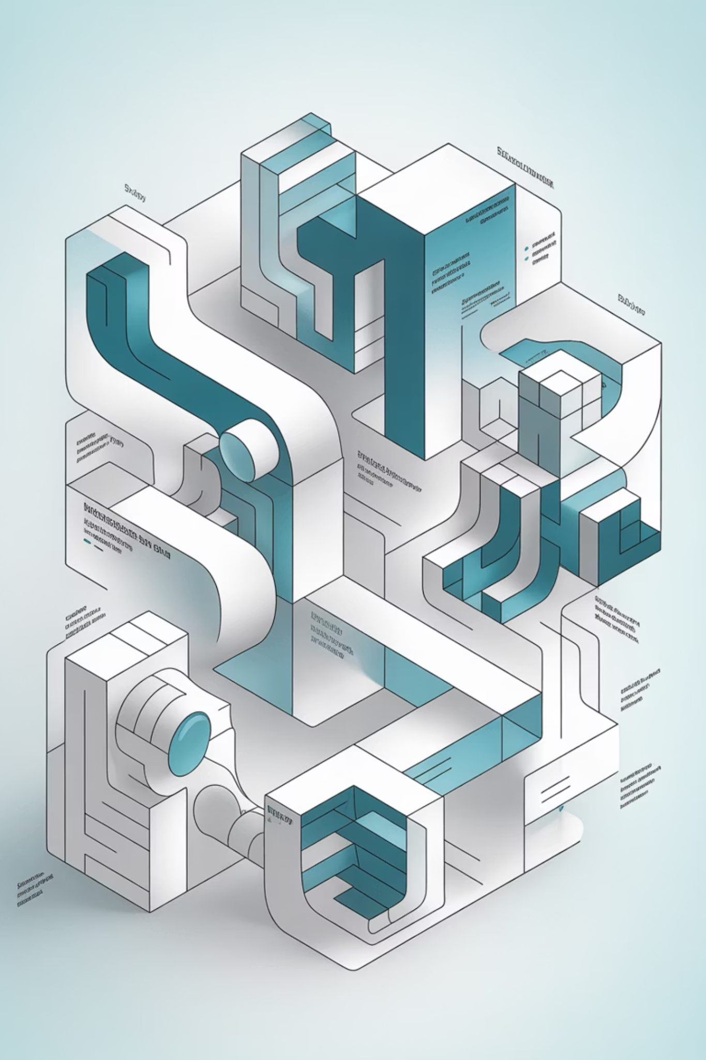
Systems and Applications
Technology systems form the backbone of modern business operations. Understanding system dependencies and vulnerabilities is essential for maintaining business process continuity during disruptions.
Core business applications: ERP, CRM, financial systems, and industry-specific platforms
Supporting infrastructure: Servers, networks, databases, and cloud services
Communication systems: Email, voice, video conferencing, and collaboration tools
Security systems: Firewalls, monitoring tools, and access control systems
Integration platforms: APIs, middleware, and data exchange systems
Backup and recovery systems: Data protection and system restoration capabilities
Notes:
Key Definition Systems/applications: technology platforms that support business operations
Core business software runs transactions
Infrastructure keeps systems available
Communication tools support teamwork
Security tools protect access
Backup tools recover lost data
Example Losing your phone’s messaging app stops your group chat — same impact when businesses lose core apps.

Slide 37

Data and Information Assets
Data represents the lifeblood of modern organizations. Identifying critical information assets and their protection requirements enables effective backup, recovery, and access strategies during business disruptions.
Customer information: Contact data, transaction history, and service records
Financial data: Accounting records, payment information, and regulatory reports
Operational data: Inventory records, supply chain data, and production information
Intellectual property: Product designs, processes, formulas, and competitive intelligence
Regulatory data: Compliance records, audit trails, and mandated reporting information
Backup integrity: Data validation, recovery testing, and version control procedures
Notes:
Data asset: information required for business continuity
Customer records support service
Financial data supports reporting
Operational data guides production
IP protects competitive advantage
Regulatory data supports compliance
Example Losing your contact list leaves you unable to reach friends — companies face the same issue with customer data.

Slide 38

People and Roles
Human resources often represent the most critical and vulnerable component of business processes. Identifying key personnel and knowledge dependencies helps prevent single points of failure in organizational capabilities.
Decision makers: Executives, managers, and authorized signatories with approval authority
Subject matter experts: Specialists with unique knowledge, skills, or system access
Key operators: Personnel who perform critical daily operations and customer service
Cross-trained resources: Staff members who can perform multiple functions during disruptions
External dependencies: Consultants, contractors, and vendor personnel essential for operations
Succession planning: Backup personnel and knowledge transfer procedures
Notes:
Role dependency: reliance on key individuals or skills
Some roles hold critical knowledge
Specialized skills not easily replaced
Decision authority impacts speed
Customer-facing roles affect service
Succession planning reduces risk
Example Only one mechanic can fix a specific motorbike model — business has same problem with specialized skills.

Slide 39

Facilities and Physical Assets
Physical infrastructure provides the foundation for business operations. Understanding facility dependencies helps identify alternate location requirements and infrastructure protection needs for continuity planning.
Primary locations: Headquarters, branch offices, and production facilities
Utilities and infrastructure: Power, telecommunications, water, and environmental systems
Manufacturing assets: Production equipment, machinery, and specialized tools
Storage facilities: Warehouses, data centers, and inventory management locations
Transportation assets: Vehicles, shipping docks, and distribution networks
Alternate locations: Backup sites, co-location facilities, and remote work capabilities
Notes:
Physical asset: building, equipment, or utility supporting operations
Buildings host teams
Utilities support systems
Equipment enables production
Storage protects inventory
Alternate sites support continuity
Example A gym without power cannot run lights or treadmills — same dependency applies to business sites.

Slide 40



Mapping Dependencies
Understanding relationships between processes and resources reveals how disruptions cascade through the organization. Dependency mapping enables proactive risk management and informed recovery prioritization decisions.
Process Dependencies
Resource Dependencies
Impact Analysis
How business processes rely on each other for inputs, outputs, and sequencing
How processes depend on specific systems, data, people, and facilities
How resource failures cascade through dependent processes and functions
Common Dependency Patterns
Linear Dependencies
Hub Dependencies
Network Dependencies
Sequential process chains
Centralized systems
Interconnected systems
Assembly line operations
Shared resources
Peer-to-peer processes
Approval workflows
Single points of failure
Distributed operations
Notes:
Dependency mapping: documenting how processes and resources rely on each other
Shows how tasks connect
Reveals hidden failure paths
Highlights critical supporting resources
Helps sequence recovery actions
Clarifies upstream and downstream flow
Example If your laptop charger fails, your laptop dies — mapping shows charger dependency on power source.

Slide 41

Tools for Process Identification
Systematic approaches and proven methodologies ensure comprehensive identification of business processes and resources. The right combination of tools provides complete visibility into organizational dependencies and risks.
Stakeholder interviews: Structured conversations with process owners and key users
Process walkthrough: Step-by-step observation of how work actually gets done
Document analysis: Review of procedures, org charts, and system documentation
RACI analysis: Responsible, Accountable, Consulted, Informed role mapping
Value stream mapping: End-to-end flow analysis from customer perspective
Risk assessment integration: Combining process identification with threat analysis
Notes:
Process identification: methods used to discover real workflow steps
Interviews capture real work
Walkthroughs show process flow
Documents reveal formal structure
RACI clarifies responsibility
Value mapping shows customer impact
Example Watching how a barista makes a latte shows each step of the process.

Slide 42

Interdependencies Between Systems and Teams
Modern organizations operate as complex networks of interconnected systems and collaborative teams. Understanding these relationships is crucial for predicting disruption impacts and designing effective resilience strategies.
Cross-functional workflows: Processes that span multiple departments and systems
Shared service dependencies: Common infrastructure used by multiple business units
Information flow patterns: How data moves between teams, systems, and external partners
Communication networks: Formal and informal channels that enable coordination
Decision-making chains: Authority relationships and approval processes across functions
External partnerships: Vendor, supplier, and customer integration requirements
Notes:
Interdependency: mutual reliance between teams or systems
Cross-functional work needs coordination
Shared systems affect multiple teams
Data flow connects departments
Communication links ensure alignment
Decisions depend on multiple roles
Example A band relies on each musician — if one instrument stops, performance suffers.

Slide 43
Prioritizing Processes and Resources
Effective prioritization enables organizations to focus limited resources on protecting and recovering the most critical capabilities first. Clear prioritization criteria guide investment decisions and response strategies during disruptions.
1
2
3
Critical (Tier 1)
Important (Tier 2)
Standard (Tier 3)
Must be recovered immediately. RTO ≤ 4 hours. Revenue-generating, regulatory-required, or safety-critical processes.
Should be recovered quickly. RTO ≤ 24 hours. Supporting processes that enable Tier 1 operations or customer service.
Can be recovered later. RTO ≤ 72 hours. Administrative processes and non-critical business functions.
Prioritization Criteria
Business Impact Factors
Operational Factors
Revenue and profitability impact
Process interdependencies
Customer service and satisfaction
Resource availability and cost
Regulatory and compliance requirements
Recovery complexity and time
Reputation and brand protection
Risk exposure and vulnerability
Notes:
Prioritization: ranking processes and resources based on business impact
Highest-impact functions restored first
Medium tier supports core operations
Low impact scheduled later
Guides allocation of limited resources
Ensures recovery aligns with business goals
Example In a power outage at home, you plug in your phone before the TV because communication matters more.

Slide 44

Linking Processes to Recovery Objectives
Process identification directly informs recovery planning by establishing realistic time and data loss objectives. Clear linkage between business requirements and technical capabilities ensures recovery strategies align with operational needs.
RTO
RPO
Recovery Time Objective
Recovery Point Objective
Maximum acceptable downtime for each identified process based on business impact analysis
Maximum acceptable data loss for supporting systems and information assets
Objective Setting Considerations
Business impact severity: Financial, operational, and reputational consequences
Resource requirements: Technology, personnel, and budget constraints
Dependency relationships: How process recovery affects other business functions
Regulatory mandates: Industry-specific requirements for availability and data protection
Customer expectations: Service level agreements and competitive positioning
Notes:
Recovery objective: target time and data loss limits for restoring a process
Processes set RTO based on impact
Defines time allowed for downtime
Guides technology recovery planning
Aligns process needs with IT capability
Ensures realistic recovery sequencing
Example You charge your phone immediately before leaving the house because you need it for directions — time sensitivity sets priority.

Slide 45

Documenting Key Findings
Systematic documentation transforms process identification results into actionable business continuity intelligence. Structured templates and consistent reporting enable effective decision-making and ongoing program management.
Process inventory: Comprehensive catalog of business processes with criticality ratings
Resource dependency maps: Visual representation of relationships and single points of failure
Recovery requirement matrices: RTO/RPO objectives aligned with business priorities
Risk exposure summaries: Vulnerability assessment results for each critical process
Action item registers: Identified gaps and improvement opportunities with assigned ownership
Executive dashboards: High-level summaries for leadership oversight and decision-making
Notes:
Key findings: validated conclusions about critical processes, impacts, and dependencies
Capture main risks and exposures
Highlight time-critical functions
Summarize major dependencies
Provide evidence for decisions
Create a record leadership can review
Example After checking your house before storm season, you write down loose shingles, weak windows, and drainage issues so you know what needs fixing first.

Slide 46

Summary and Key Takeaways
Key processes define what the business must protect and recover first during disruptions
Systems, data, people, and facilities are interdependent resources requiring coordinated protection
Proper mapping supports business impact analysis, risk assessment, and continuity planning outcomes
Continuous documentation keeps resilience efforts current with evolving business requirements
Understanding what keeps the business running is the first step to protecting it effectively
Connection to DRI Framework
Process and resource identification directly supports DRI Professional Practices 3 (Business Impact Analysis) and 5 (Emergency Response and Operations). Master these fundamentals to build comprehensive continuity capabilities that protect organizational value and stakeholder interests.

Slide 47
Lab Time
1 Hour
Notes:
https://www.ncsc.gov.uk/static-assets/documents/PwnedPasswordsTop100k.txt

Slide 48

Debrief, Discussion, and Recap
This discussion ties together how risk assessment, business impact analysis, and process identification work as a unified foundation for organizational resilience. These three critical components form the cornerstone of effective business continuity and disaster recovery planning.
Reinforce main takeaways from each lesson
Connect concepts to DRI certification practices
Encourage real-world reflection and application
Prepare learners for assessments and practical implementation
1
Notes:
https://www.ncsc.gov.uk/static-assets/documents/PwnedPasswordsTop100k.txt

Slide 49

Connecting the Three Lessons
Risk assessment, business impact analysis, and process identification form the foundational triad of continuity management. Each component strengthens and informs the others, creating a comprehensive understanding of organizational vulnerabilities and priorities.
Risk Assessment identifies potential threats and vulnerabilities that could disrupt operations
BIA determines which functions matter most and establishes recovery priorities
Process Identification maps the resources that make those critical functions possible
Together, they define what must be protected and how protection should be implemented

Slide 50

Recap: Risk Assessment for Resilience Planning
Risk assessment serves as the foundation for proactive resilience by systematically identifying and evaluating potential threats to organizational operations. This process enables informed decision-making about risk treatment strategies.
Identifies likelihood and impact of potential disruptions across all threat categories
Informs critical mitigation, transfer, acceptance, and avoidance decisions
Forms the analytical base of the resilience lifecycle and continuity planning
Directly supports DRI Practice 2: Risk Assessment certification requirements

Slide 51

Recap: Purpose of BIA – Identifying Essential Functions
Business Impact Analysis serves as the strategic compass for continuity planning by determining time-critical functions, their dependencies, and the consequences of their disruption. This analysis drives resource allocation and recovery prioritization decisions.
Determines time-critical functions and their interdependencies across the organization
Links operational disruptions to financial, reputational, and regulatory impact
Informs recovery time objectives and resource allocation for continuity strategies
Essential component of DRI Practice 3: Business Impact Analysis framework

Slide 52

Recap: Identifying Key Processes and Resources
Process and resource identification provides the operational blueprint that supports both risk assessment and BIA activities. This detailed mapping reveals the critical infrastructure, systems, and dependencies that enable business functions.
Defines systems, data, people, and facilities needed to maintain critical operations
Reveals hidden dependencies and potential single points of failure
Enables targeted resilience investments and recovery strategy development
Directly supports DRI Practice 5: Implementation of continuity solutions

Slide 53

Discussion and Reflection
Now let's connect these foundational concepts to your real-world experience and organizational context. Use these discussion prompts to reflect on how these elements work together in your current environment.
Discussion Prompts:
Which activity (Risk Assessment, BIA, or Process Identification) do you find most challenging to implement effectively?
How do these three elements support and strengthen each other in your workplace?
Where do you see the biggest gaps in real-world implementation within your organization?
What quick win could you implement tomorrow to improve organizational resilience?

Slide 54

Summary and Key Takeaways
Risk Assessment = identifying and analyzing threats and vulnerabilities
BIA = defining what matters most and establishing recovery priorities
Process Identification = mapping how critical functions connect and operate
Combined, these three elements form the analytical core of resilience readiness
Strong resilience starts with knowing your risks, understanding your priorities, and protecting your key processes.

Slide 55
Kahootz & Quiz Time
Notes:
https://www.ncsc.gov.uk/static-assets/documents/PwnedPasswordsTop100k.txt

